Slide 1
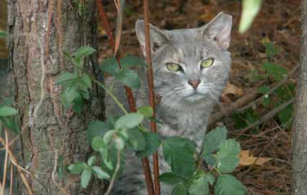
Feral Cats & TNR
Lizhu Li
Credit to: Stephanie Janeczko, DVM, MS, DABVP, CAWA

Slide 2
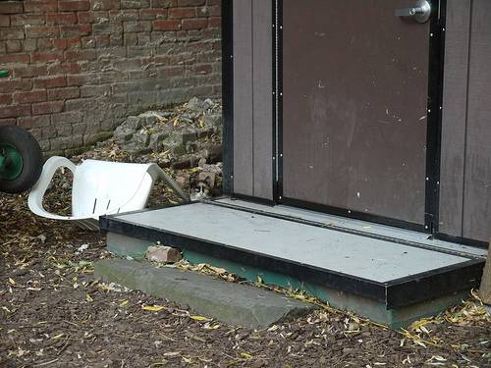

Slide 3
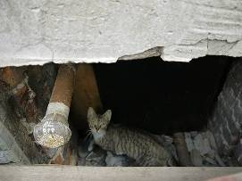
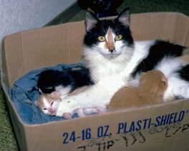
Feral cats & feline overpopulation
More cats than dogs:
Entering U.S. shelters
Living in U.S. homes
Outside in the U.S.
Why are cats in trouble?
Unique reproductive features
Kittens have kittens
Kittens with kittens have kittens
Physical changes absent, nocturnal behavior
Second class status
Less care
Less understood, few laws

Slide 4

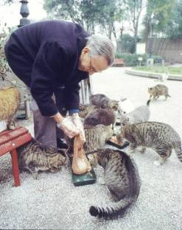
There are a lot of cats out there….
How many are spayed or neutered?
Owned cats vs. free-roaming

Slide 5
There are a lot of cats out there….
How many are spayed or neutered?
Owned cats vs. free-roaming

Slide 6
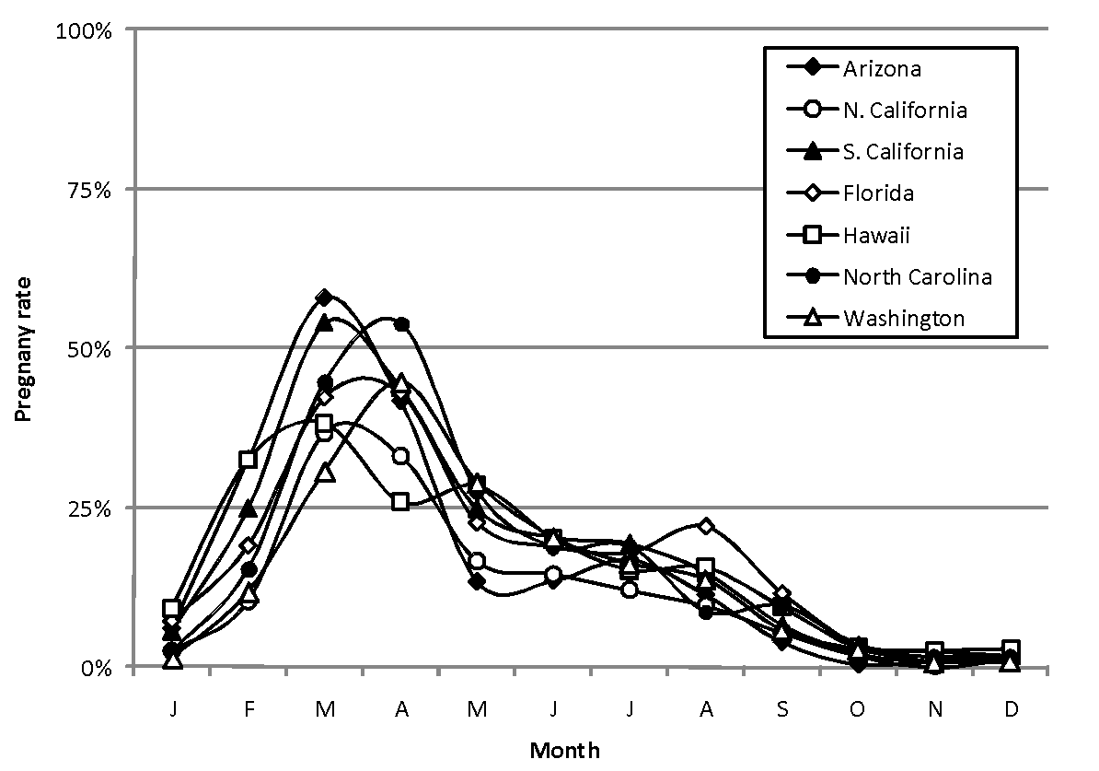
Reproduction specialists
~103,000 cats from 7 sterilization organizations in the U.S.
(Wallace JFMS 2006)
Notes:
‹#›

Slide 7
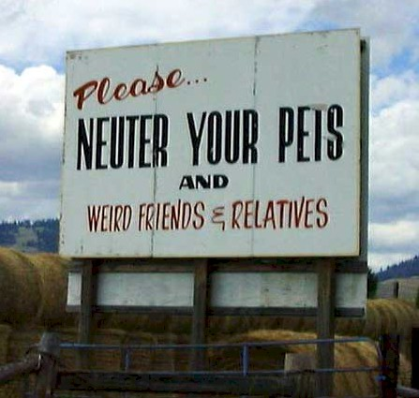
The Solution?

Slide 8
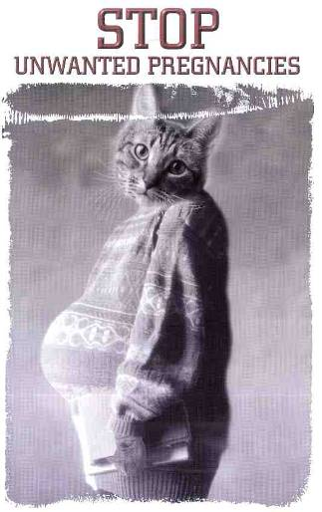

Slide 9
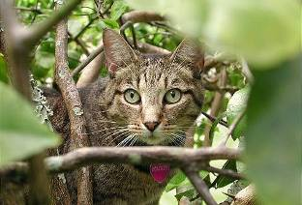
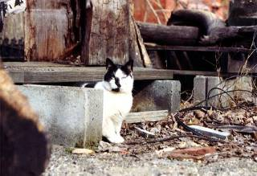
What is a feral cat?
Outdoor cats represent a continuum of life-styles, from socialized owned cats to socialized free-roaming cats to unsocialized feral cats
Feral cats:
Unowned outdoor cats
“Touch barrier” – will not accept human contact
Must be trapped in order to be presented for care

Slide 10
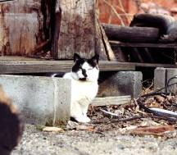
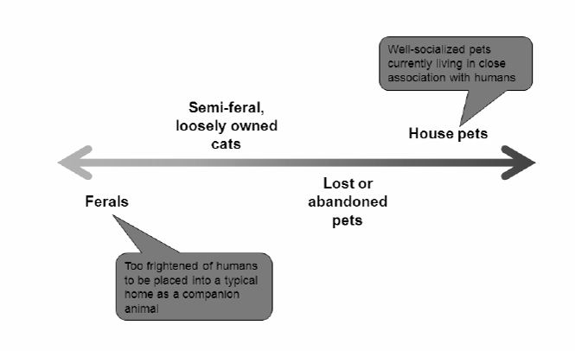
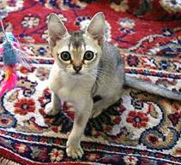
What is a feral cat?
Continuum of life-styles
Credit: Jesse Oldham, ASPCA

Slide 11
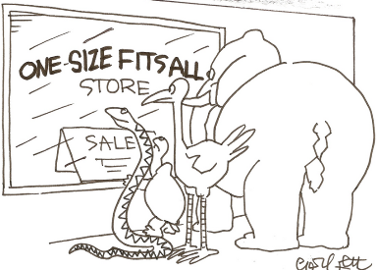
What to do with feral cats?
No one approach is perfect or right for every situation
Need to consider public perception, available resources, climate, magnitude of the problem
Comprehensive, multi-faceted programs most likely to succeed
Improve cats’ welfare
Protect public health
Reduce nuisance complaints
Safeguard the ecosystem, reduce environmental concerns
Reduce shelter intake, euthanasia

Slide 12
Don’t discount public perception of ferals
Range of opinions on free-roaming cats – beloved companions to vermin
As many as 20% feed outdoor cats
Some are active TNR participants
Others view cats as a nuisance to be eliminated
2005 move to legalize cat hunting in Wisconsin
2008 bounty of $5/cat in Iowa town
Any plan to manage free-roaming cats must consider public opinion

Slide 13
AAFP Position statement
The American Association of Feline Practitioners (AAFP) supports the welfare of all cats, and strongly supports public education and efforts to promote responsible care of unowned, abandoned, and feral cats… Ignoring this population has implications for the welfare of the cats themselves, public health, wildlife and ecosystems.
The public, wildlife, and feline (populations) stand to benefit from the reduction in population of free-roaming… cats.
The AAFP strongly supports reducing the numbers of unowned, free-roaming, abandoned, and feral cats through humane capture (with placement in homes where appropriate) by local health departments, humane societies, and animal control agencies in accordance with local and state ordinances.
The AAFP supports non-lethal strategies to promote population reduction…

Slide 14
AAFP Position statement
Permanent, enduring solutions to the problem of free-roaming, abandoned and feral cats will be achievable when:
State and local agencies provide significantly increased funding to animal control agencies
Concerted and sustained public educational campaigns aimed at highlighting the problems associated with unowned cats and the solutions to these problems are in place.
An environmentally safe and effective non-surgical contraceptive is developed.
Until such permanent solutions are achieved, alternate humane solutions exist… appropriately managed cat colonies.

Slide 15
AAFP Position statement
The goal of colony management should be the eventual reduction of the colony through attrition… managed colonies are controversial; however, properly managed programs promote the quality of life of cats through nutrition, vaccination, decreasing the numbers of unwanted litters, euthanasia of sick and debilitated cats, and adoption of healthy kittens. Appropriately managed colonies also significantly decrease the risk to public health, wildlife, and ecosystems.
Since a “Do Nothing” approach is non-productive, positive public involvement should be encouraged to help develop solutions and direct public behavior towards existing alternatives
Full position statement available at http://www.catvets.com/uploads/PDF/Free%20Roaming%202012.pdf

Slide 16

A brief history of TNR
Publications as early as 1900s in United States
Started as management strategy in MA in 1980
Foundation of Alley Cat Allies in 1990
Source of information, networking, resources for individuals and groups
Increasing visibility, concern, education by late 1990s
Veterinary colleges, AVMA, AAFP, others
Increasing availability of CE for shelter and veterinary professionals
University campus programs more common
Becoming “mainstream” topic and practice

Slide 17
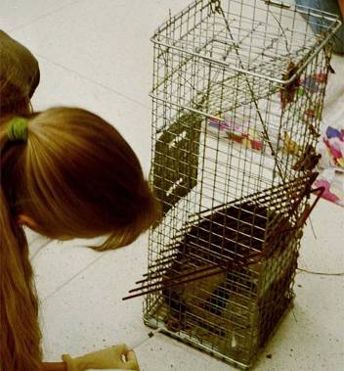
Trap Neuter Return
More humane method of management
Fosters compassion and societal responsibility
Fosters respect for life
If performed on a large scale, decreases shelter impoundments and euthanasia rates

Slide 18
Trap Neuter Return
More cost effective than trap-euthanasia
Expense of officer response to nuisance complaints
Expense of impoundment/holding period prior to euthanasia
Community volunteers will often trap cats for surgery, but not for euthanasia

Slide 19
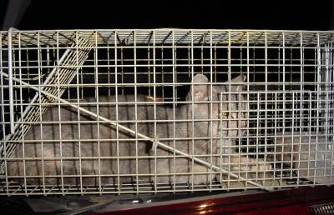
Benefits of Trap-Neuter-Return
Population stabilization
Increased herd immunity – lower risk of infectious diseases
Reduction of nuisance problems
Less fighting, roaming, howling
Reduction of concerns surrounding cats’ welfare
Better body condition, kitten mortality eliminated
Greater acceptance by the public

Slide 20
Is TNR humane and safe?
Feral kitten mortality exceeds 50%
TNR reduces roaming, fighting, infectious diseases
Feral cats gain weight and fat following sterilization
Risk of death during trapping and surgery is low (0.4%), and euthanasia for humane reasons is uncommonly required (0.3%)
Feral cats may live for many years
Many “feral” cats are adopted
(Scott JAVMA 2002, Scott JAAWS 2002, Nutter JAVMA 2004, Levy JAVMA 2003, Wallace JAVMA 2006)
Notes:
‹#›

Slide 21
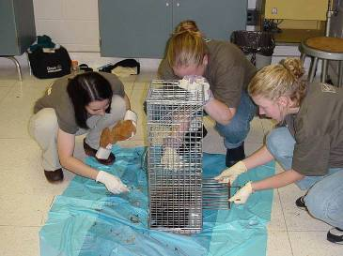
Trap-Neuter-Return
Cats undergoing TNR are:
Humanely trapped and transported for surgery
Examined under anesthesia
Spayed or neutered
Vaccinated against rabies +/- FVRCP
+/- FeLV/FIV tested
Ear-tipped
Returned to their home

Slide 22
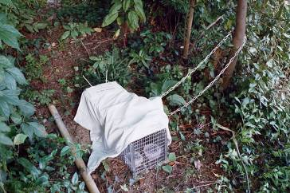
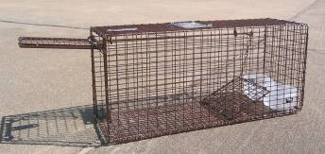
Humane Trapping
Can be harder than it looks!
Entrain cats to a feeding routine.
Optimum trapping is from dusk until dawn
Get the property owner’s permission, post signs
May need a variety of traps:
Tomahawk live traps
TruCatch or similar box type live trap
Drop trap

Slide 23
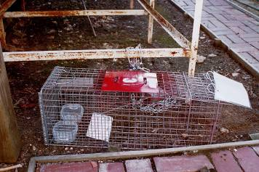
Tips for Trapping
Withhold food 24-48 hours in advance
Easier to trap
Better for surgery
Trap where you feed
Where to set traps
Level area
Discrete area out of public view
Trap out all members of a colony at once if possible

Slide 24
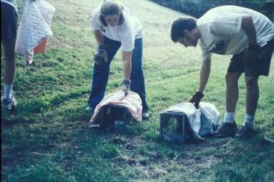
Trapping should minimize stress
Trap on a level surface with smelly bait and always COVER traps
Keeping a trapped cat covered and calm impacts the disposition of the cat later and projects a professional image to the public
Reducing stress also improves outcome for the cats
Response to vaccination
Anesthetic risk decreased

Slide 25
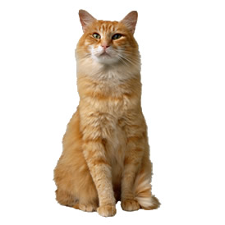
What cats are…
Both predators and prey - Fight or flight
Physiology
Adrenaline release
Prepares body for action
Increase blood pressure, heart rate, respiratory rate, cardiac output
Most potent stimulus is apprehension (stress!)

Slide 26

Physiological Results of Stress
Adrenaline
Decompensation/death of ill cats
Normal cats
Changes in blood parameters
Anesthetized cats
Need for more drugs
Increased risk of arrhythmias, complications
Other hormones: cortisol
Chronic stress lowers immunity, increases susceptibility to disease

Slide 27
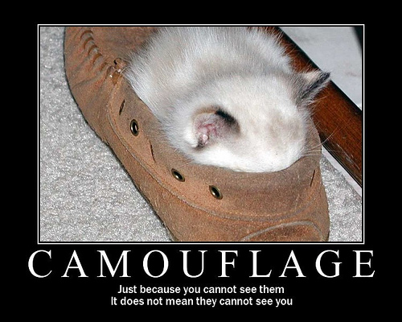

Slide 28
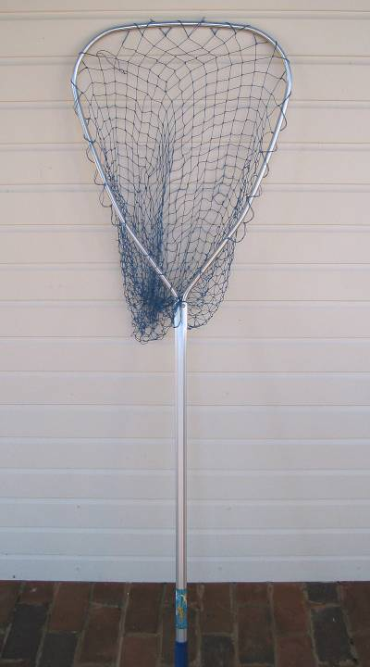
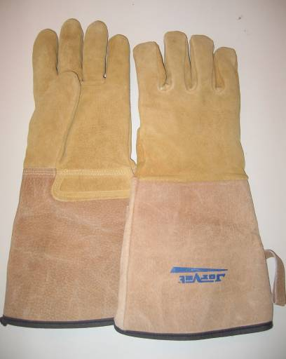

Slide 29
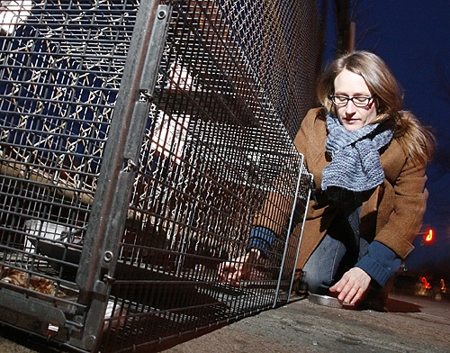

Slide 31
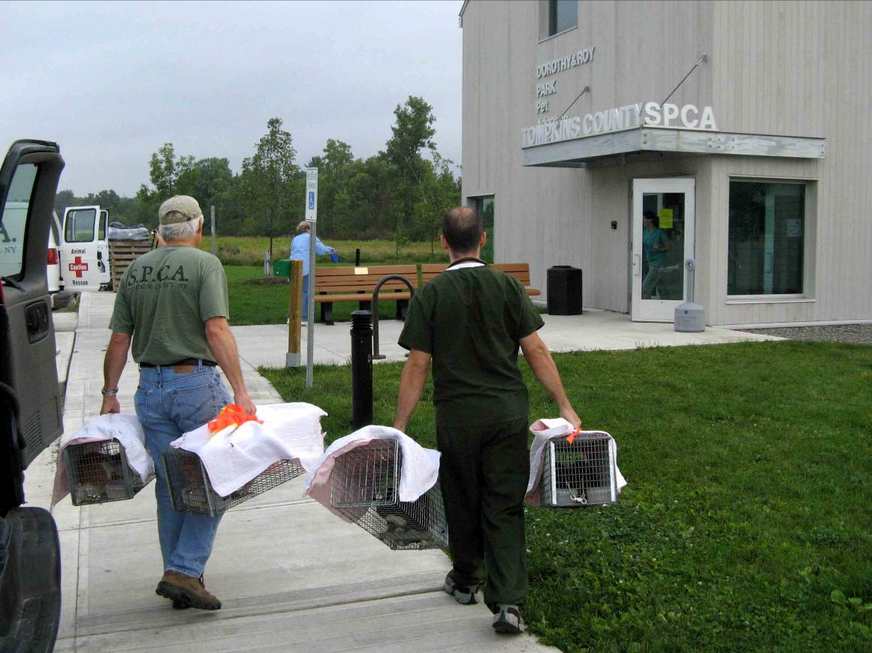

Slide 32
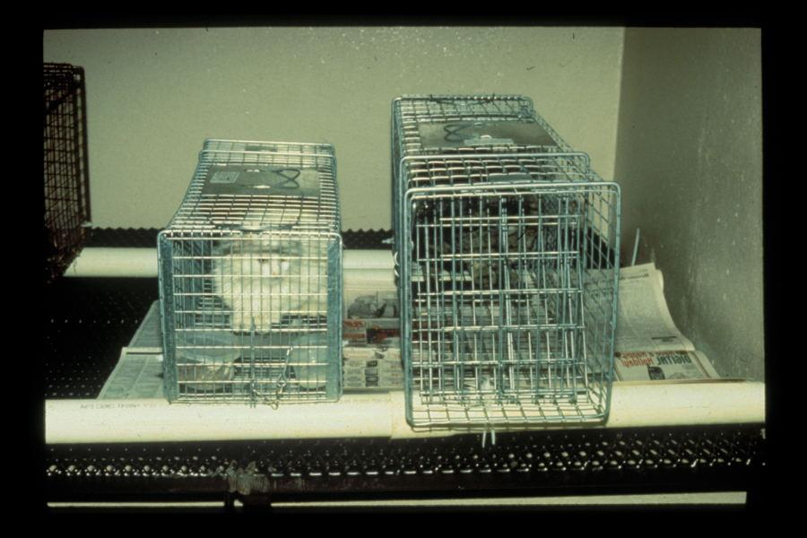

Slide 33
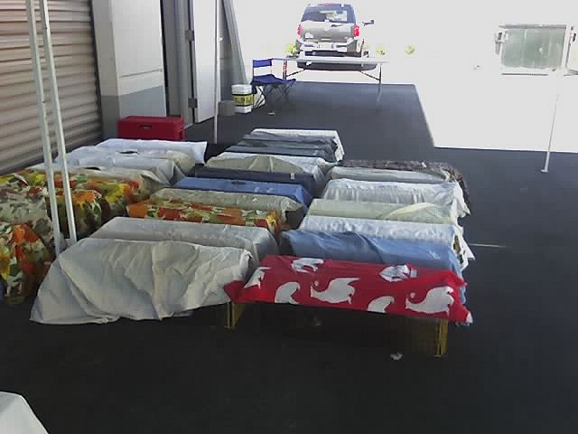

Slide 34
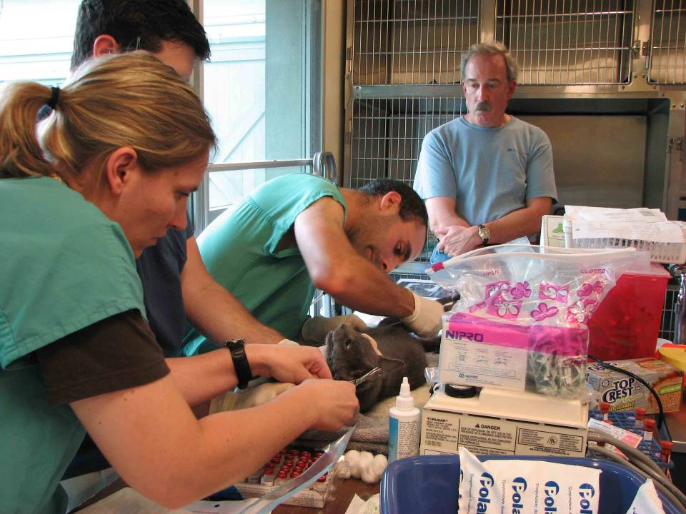

Slide 35
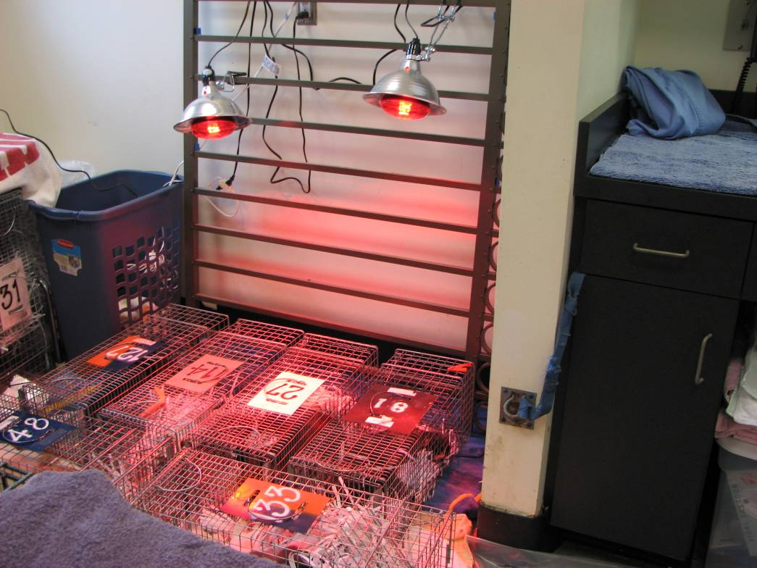

Slide 36
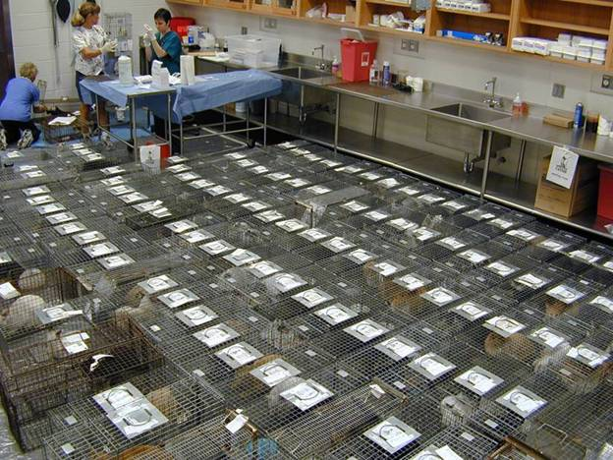
Notes:
‹#›

Slide 37
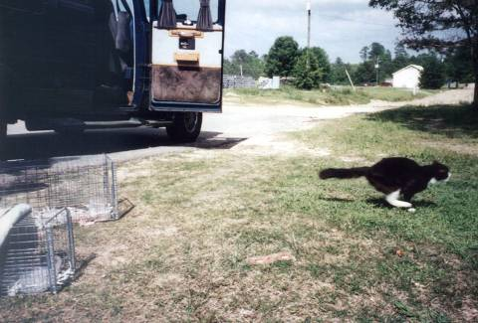

Slide 38
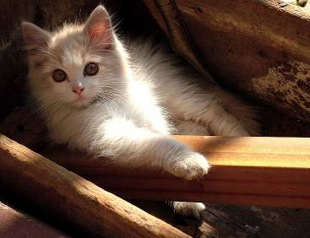
Young kittens should be rehomed
Highest mortality rates – 50%, up to 75%
Remove from colony: tame/socialize, adopt out
Younger = easier
Generally under 10-12 weeks
If unable, humanely euthanize

Slide 39
Special Considerations
Working with feral cats is not like working with pet cats or stray cats!
Good practices are key to minimizing stress and ensuring safety for both the cats and people ☺
ALWAYS sedate a feral cat while in the trap
Make sure you have the appropriate equipment on hand
Humane traps, trap dividers, safety gloves
Newspapers, disinfectants, paper towels
Food and water
Covers for traps
Have a system in place to track cats and get them back to their trap (e.g. paw tags)
Have medical supplies as needed
Vaccinations
Dewormer, flea treatment
Euthanasia solution
http://www.alleycat.org/page.aspx?pid=455

Slide 40
Anesthesia and Surgery
Hands-on physical examination performed under anesthesia for safety
Many anesthetic protocols exist
Give drugs without handling the cat – have the proper equipment
Example: TKX
Telazol reconstituted with ketamine and xylazine
Safe, economical and feasible for use in large scale surgery clinics
Hypoxemia may occur; post-op analgesia for females not optimal – need extra medication Many protocols exist
Surgery largely the same
Recover in trap
Feed once awake
Release the next day if active, eating, no obvious clinical concerns

Slide 41
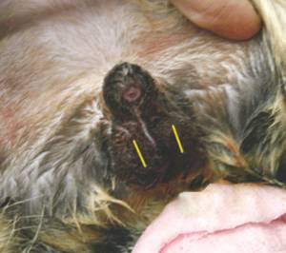
How is a neuter performed?
Under general anesthesia
Incision made to remove the testicles
Generally scrotal
Left open to drain

Slide 42
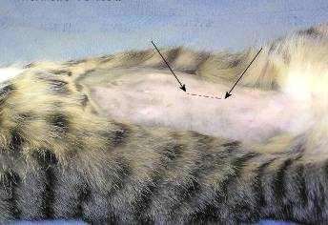
How is a spay performed?
Under general anesthesia
Incision made along the middle of the belly
Remove both ovaries and the uterus
Bigger surgery than a neuter – more invasive, harder to perform, more concerns about recovery

Slide 43
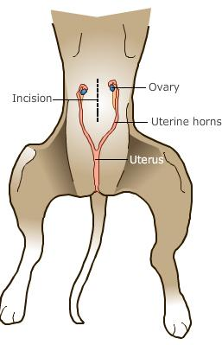
“Regular” Spays
Ventral midline approach to remove the ovaries +/- uterus
Benefits:
Typical approach most people know
Can visualize other internal organs
Can extend incision as needed
Bleeding
Pregnancy

Slide 44
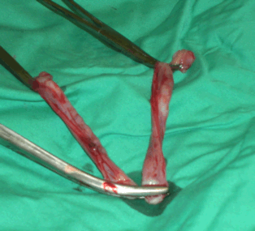
“Regular” Spays
Ventral midline approach to remove the ovaries +/- uterus
Benefits:
Typical approach most people know
Can visualize other internal organs
Can extend incision as needed
Bleeding
Pregnancy

Slide 45
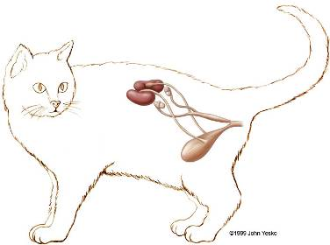
Flank Spays
Lateral approach to remove the ovaries +/- uterus
Skin incision followed by blunt dissection through the muscle layers
Benefits:
Still able to spay when ventral midline approach isn’t possible
Lactating
Mammary gland hyperplasia
Skin infections
Allows for easy visual by caretakers
May be less likely to have serious complications with dehissence (?)

Slide 46
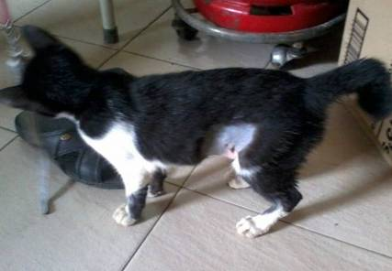
Flank Spays
Lateral approach to remove the ovaries +/- uterus
Skin incision followed by blunt dissection through the muscle layers
Benefits:
Still able to spay when ventral midline approach isn’t possible
Lactating
Mammary gland hyperplasia
Skin infections
Allows for easy visual by caretakers
May be less likely to have serious complications with dehissence (?)

Slide 47
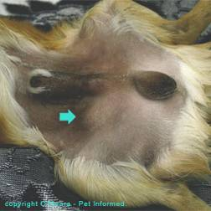
What about cryptorchids?
What’s a cryptorchid?
Undescended testicle(s), usually just one
How do you do that surgery?
Always remove both testicles
Look in the groin area and/or abdomen
May look like they’ve been spayed once done

Slide 48
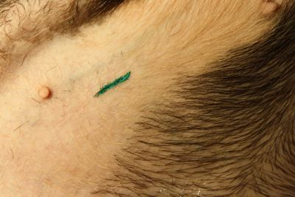
Now we’re tattooing pets???
Easy, definite identification!
Scars can be faint and hard to find, especially if surgery was done at a young age
Scar on the belly may not be from a spay
Not finding a scar is:
Frustrating and takes time, at best
May lead to an unnecessary surgery

Slide 49

Identification for Feral Cats?
Removal of the distal tip of the ear – universal symbol of a cat from a TNR program
Many benefits:
Visual from a distance
Inexpensive
Easily understood by the public, other agencies
It’s not just cutting off part of the ear – it’s an art form!

Slide 50
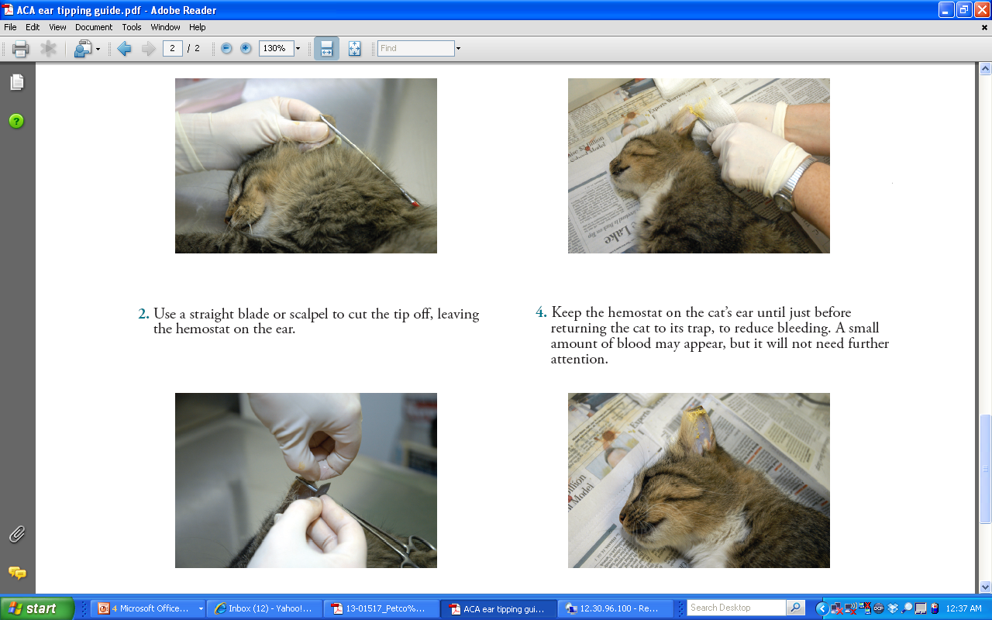
Ear tipping
Removal of the distal portion of the ear
Enough so that it’s distinguishable from scars from fighting or frostbite
Not so much that it doesn’t heal

Slide 51
Ear tipping
Removal of the distal portion of the ear
Enough so that it’s distinguishable from scars from fighting or frostbite
Not so much that it doesn’t heal

Slide 52
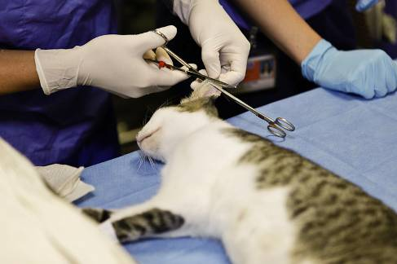
Ear tipping
Removal of the distal portion of the ear
Enough so that it’s distinguishable from scars from fighting or frostbite
Not so much that it doesn’t heal

Slide 53
Ear tipping
Removal of the distal portion of the ear
Enough so that it’s distinguishable from scars from fighting or frostbite
Not so much that it doesn’t heal

Slide 54
Ear tipping
Removal of the distal portion of the ear
Enough so that it’s distinguishable from scars from fighting or frostbite
Not so much that it doesn’t heal

Slide 55

Ear tipping
Removal of the distal portion of the ear
Enough so that it’s distinguishable from scars from fighting or frostbite
Not so much that it doesn’t heal

Slide 56
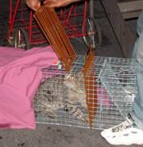
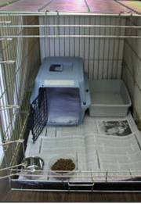
Recovery Time!
Always recover a feral cat in the trap – their own clean trap!
Provide an appropriate recovery space
Flat, clean, dry, and warm
Minimal noise
Observed for post-op complications
Once awake – feed kittens right away, adults a bit later
Written instructions to caregivers for post-op care
What to watch for
Who to contact if there are post-op difficulties
When to release
Usually the day following surgery if no problems
ASAP for nursing queens
Longer hold requires an appropriate set-up for humane care

Slide 57
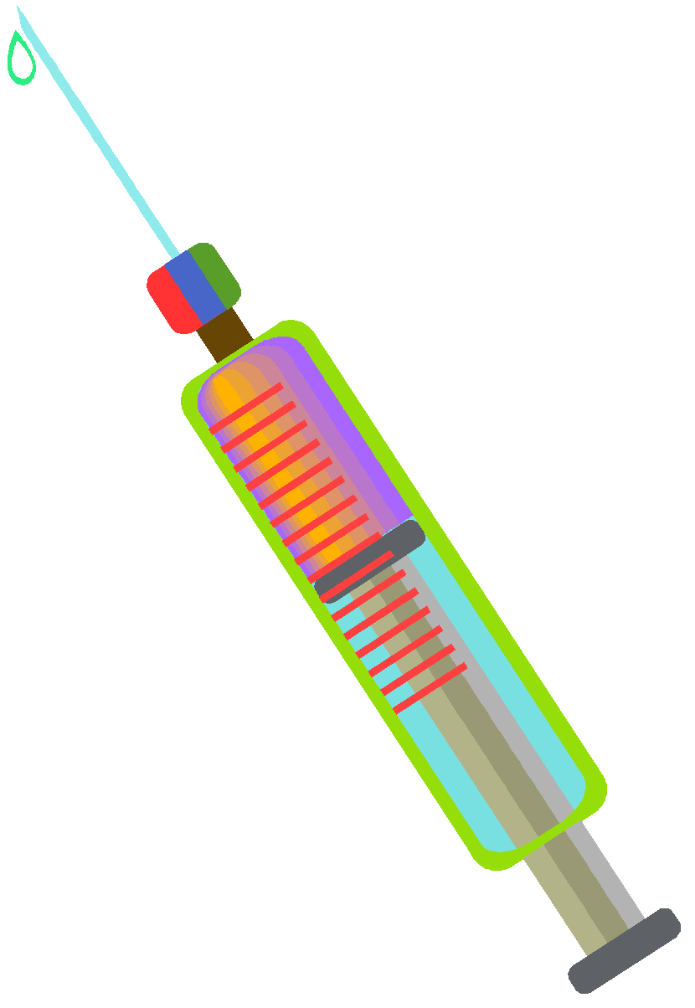
Vaccinations
ONE component of a herd health program
NOT a magic bullet
But, an important tool in maintaining the health of all cats… including ferals

Slide 58

Vaccines: The Basics
Lessen the severity of future diseases
Prevent SOME diseases altogether
Vaccines = actual live viruses
Similar to the ones that cause disease
Result in antibody production that provides protection against the real thing
Need to be handled carefully & administered appropriately

Slide 59
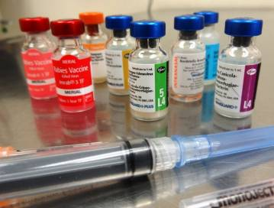
Feral Cats: Core Vaccinations
Rabies (3yr DOI) – huge public health benefit
FVRP strongly recommended:
Feline Viral Rhinotracheitis (Herpes)- URI
Calicivirus- URI
Panleukopenia (feline parvovirus)

Slide 60
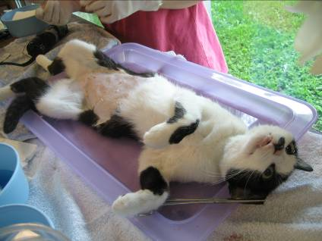
Can an animal even respond to a vaccine if we give it the same day as surgery?
The short answer 🡪 Yes!
The long answer 🡪 Yes, as best we can tell from the few studies that have looked at this situation

Slide 61
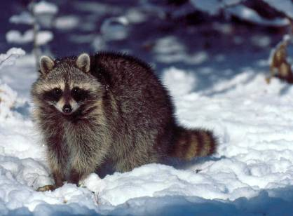
Surely someone must have done some research on this important question….
Sadly, only a few studies have been carried out in animals looking at this very question
Existing literature seems to support administration of vaccines on the day of surgery
Much of this has been carried out in zoo and/or wildlife species and is extrapolated to cats

Slide 62

What’s been published on the topic
Best evidence to date: a prospective study looking at response to vaccines given at surgery!
61 cats (4+ months old) in a TNR program
Trapped, anesthetized, sterilized, vaccinated post-op against FVRCP, Rabies, FeLV
~50% with MLV product, ~50% with killed product
Trapped and sedated again later for blood draw
Significant increase in the proportion of cats with protective levels of antibodies following vaccination ☺

Slide 63

What’s been published on the topic
There was a significant increase in the number of cats with protective levels of antibodies following vaccination ☺
 | Before vaccination | After vaccination
Panleuk | 33% | 90%
Herpes | 21% | 56%
Calici | 64% | 93%
Rabies | 3% | 98%

Slide 64
So what does this all mean?
Anesthesia/surgery does not substantially interfere with an animal’s ability to mount an immune response to a vaccine:
BUT, a few caveats:
Studies have been limited, looked only at titers
Giving a vaccine is not a guarantee of immunity.
Proper storage, handling, administration is a must!
Even still, some cats will fail to respond
Maternal antibody interference in kittens
Underlying disease, severe stress, or administration of medication (e.g. steroids)
Overwhelming exposure

Slide 65

To test or not to test?
Goal with testing is removal of infected cats from population – to decrease transmission
BUT, Spay/neuter alone greatly reduces risk of transmission
Less fighting = less FIV transmission
Less breeding = less FIV and FeLV transmission

Slide 66

To test or not to test?
What is the best use of limited resources?
Similar incidence in pet cats – 3-4%
Cost is significant – kits cost over $12/each, take time to run
Risk of false positives
Concerns about euthanasia of healthy infected cats

Slide 67


FeLV/FIV: 18,038 pet and feral cats
Healthy cats
Sick cats
(Levy 2006 JAVMA)
Notes:
‹#›

Slide 68

FeLV screening
Over the course of a year, you test 1000 cats through a TNR program
PPV =
39
67.2%
1000 cats
39 + 19
39
19
NPV =
1
941
941
99.9%
941 + 1
39
941
Sensitivity =
Specificity =
39 + 1
941 + 19
98%
98%
Notes:
‹#›

Slide 69
 | Model 1 No sterilization No testing | Model 2 Sterilize 500 Remove FeLV+ | Model 3 Sterilize 1,000 No testing
Percent FeLV+ | 4% | 4% | 4%
Adults sterilized | 0 | 500 | 1000
Adults left intact | 1000 | 500 | 0
FeLV+ euthanized | 0 | 20 | 0
Adults left FeLV+ | 40 | 20 | 40
Kittens born | 3000 | 1440 | 0
FeLV+ kittens | 90 | 43 | 0
Total FeLV+ cats | 130 | 63 | 40
Testing and removal of FeLV+ cats has less of an impact than sterilization at reducing the prevalence and spread of disease.
Slide credit: Dr. Julie Levy, University of Florida
Notes:
‹#›

Slide 70

Do feral cats pose a serious public health threat?
Risk is there but not high
Most feral cats have minimal human contact
Proper precautions by caregivers
Concerns:
Giardia, Cryptosporidium
Intestinal parasites
Toxoplasmosis
Rabies
Others
TNR managed colonies reduce risk:
Represent cat control, decreasing cat numbers
Vaccination and monitoring reduces risk of disease transmission to humans

Slide 71

Disease transmission
Yes, you still have to worry about disease transmission even though they are living outside!
Not all diseases are transmitted the same way...
Direct contact
Fecal/urine contamination, secretions, excretions
Vectors – fleas, ticks, mosquitoes
Inhalation
Ingestion
Fomites***

Slide 72

?
?
?
?
?
?
?
What is a fomite?

Slide 73




So what is a fomite?
An inanimate object (such as a toy, food bowl, mop, etc.) that may be contaminated with infectious organisms and serve in their transmission

Slide 74

General Sanitation Principals
Remember: some organisms very stable in environment– hard to kill (parvo, panleuk, calici, coccidia, ringworm)
The more porous, the more organic the material 🡪 the harder it is to clean
Use dedicated cleaning equipment
Laundry- hot water and bleach; if heavily soiled: discard
Notes:
Examples: stainless steel, concrete, plastic, dirt/grass

Slide 75



Cleaning & Sanitation Protocols
There are TWO steps here!
Step 1: Clean
Remove organic material
Detergent activity– soap it up!
Elbow grease! (mechanical cleaning)
Step 2: Disinfect
Kills the germs
Apply to clean surfaces, sit for 10min

Slide 76

Order of Cleaning
Cleanest 🡪 Dirtiest
Least contaminated 🡪 Most contaminated
Most vulnerable 🡪 Least vulnerable

Slide 77

Common Disinfectants
Quaternary ammonium compounds
Roccal, Parvo-sol, Maxxon, A33, many others
Sodium hypochlorite - Household bleach (5%)
Potassium peroxymonosulfate - Trifectant
Calcium hypochlorite - Wysiwash
Sodium dichloroisocyanurate - Bruclean
Accelerated hydrogen peroxide - AccelTB
Chlorhexidine - Nolvasan
Ethanol - Alcohol hand sanitizer

Slide 78
Common Disinfectants
Quaternary ammonium compounds
Roccal, Parvo-sol, Maxxon, A33, many others
Sodium hypochlorite - Household bleach (5%)
Potassium peroxymonosulfate - Trifectant
Calcium hypochlorite - Wysiwash
Sodium dichloroisocyanurate - Bruclean
Accelerated hydrogen peroxide - AccelTB
Chlorhexidine - Nolvasan
Ethanol - Alcohol hand sanitizer

Slide 79



Newer Disinfectants
Several recently introduced to the market – seem promising
Calcium hypochlorite - e.g. Wysiwash® and Sodium dichloroisocyanurate - e.g. Bruclean®
Dry tablets, special applicator system
No detergent activity, inactivated by organic matter
Accelerated hydrogen peroxide - e.g. AccelTB®
Liquid form, more options for application
Good detergent activity, short contact time
Less inactivated by organic material

Slide 80




A few words on bleach
Bleach is an excellent disinfectant – but it is frequently misused
At best – doesn’t work
At worst – can hurt the cats, ruin your facility
The ground rules:
You can’t clean with bleach
You must mix it appropriately and let it sit
More isn’t better
Mixing bleach
Use a measuring cup!!!
Mix fresh daily, keep covered, discard if soiled

Slide 81
A few words on bleach
Regular use = 1:32 dilution
½ cup regular household bleach per gallon of water
Will work for non-enveloped viruses
Ringworm or “deep cleaning” use = 1:10 dilution
Not for regular use
Irritating to the respiratory tract, corrosive
Must remove animals and have good ventilation

Slide 82

Phenols
Excellent disinfectant properties - will kill lots of pathogens of concern… but can also kill cats ☹

Slide 83
Phenols
Excellent disinfectant properties - will kill lots of pathogens of concern… but can also kill cats ☹

Slide 84


WASH YOUR HANDS!!!
The best practice!
Nobody likes a fomite ☺
Ideally, sinks in every room
Good old-fashioned soap and water
30 seconds contact time
Sing the alphabet song twice!
Scrub those germs away!

Slide 85

What about hand sanitizers?
Not a substitute for hand washing
Limited efficacy against non-enveloped viruses
Certain areas, animals only
Need to be used correctly
Need products with high alcohol concentrations
Ineffective in presence of organic debris (no dirty hands)
Require 20-30 seconds of contact time!

Slide 86
What about the spay shot?
Currently no safe, tested, and approved method exists for sterilizing cats without surgery
But, it is on its way!
Alliance for Contraception in Cats & Dogs
Ideal product:
Induce permanent sterilization in a single dose
Provide beneficial non-reproductive effects
Effective in dogs and cats of both sexes and all ages
Safe and easy to administer
More likely? A product that lasts for three years with a single injection

Slide 87
What about birth control of feral cats?
I’ve heard about something called Feral Stat…
What it is: short-term oral contraception designed to be added to the feral cats’ food
Sounds way easier than trapping and taking for surgery… why don’t we just use that?
Problem #1: the active ingredient is megestrol acetate – can cause mammary gland tumors, diabetes
Problem #2: who else is eating it beside the feral cats?

Slide 88
What about birth control of feral cats?
Sounds way easier than trapping and taking for surgery… why don’t we just use that?
Problem #3: it needs to be mixed in the food once a week… so how do you know a cat gets his or her full dose? How do you know all cats got their dose?
Problem #4: it has been provided by prescription by a veterinarian in Connecticut (which may or may not be legal)
Problem #5: there is no data regarding safety of efficacy (see problem #1)

Slide 89


ASV Guidelines - Spay/Neuter
Sections include:
Veterinary Medical Guidelines
Surgery and Anesthesia
Identification of altered animals
http://www.sheltervet.org
http://avmajournals.avma.org/doi/pdf/10.2460/javma.233.1.74
Notes:
Selection of a calm, private, quiet environment, and allowing time for animals to acclimate prior to handling can help minimize stress and reduce the amount of restraint required.
‹#›

Slide 90
S/N Vet Med Guidelines
Vet must make the final decision regarding surgery based on physical exam, history, and capacity of the surgery schedule
Patients should be in good health and free from signs of infectious or other disease
Must weigh the risks and benefits of proceeding if mild conditions exist
Future opportunities?
Alternative outcome may be euthanasia?
Notes:
‹#›

Slide 91

S/N Vet Med Guidelines
Cats and dogs who are pregnant, in estrus, or have pyometra, as well as those with mild upper respiratory disease, can be safely spayed or neutered in most cases.
Notes:
‹#›

Slide 92
S/N – Surgery & Anesthesia
Appropriate housing must be provided for each animal before and after surgery.
Enclosures must be:
Secure and provide a flat surface
Clean, dry and warm with adequate space for the animal to turn around
While allowing for safety & good visibility by the staff
Notes:
‹#›

Slide 93

S/N – Surgery & Anesthesia
Animals who are feral or difficult to handle should be housed in enclosures that allow for administration of anesthetics without extensive handling, and they should be returned to their enclosures when adequately recovered but prior to becoming alert.
Ideally, dogs and cats should be housed in separate areas.
Notes:
‹#›

Slide 94

S/N – Surgery & Anesthesia
Operating area must be:
Dedicated to surgery
Contain the necessary equipment for anesthesia and monitoring
Notes:
‹#›

Slide 95

S/N – Surgery & Anesthesia
Infectious disease control must be practiced to prevent transmission among patients
Aseptic surgical technique and separate sterile instruments are required
Notes:
‹#›

Slide 96







Thank you!

Slide 97

stephanie.janeczko@aspca.org
(212) 876-7700 x4406
sdj7@cornell.edu

Slide 98


